Slide 1


Conceptual Clarity and terminology of Hate-speech Intensity Scale
Thesis
Fall 2021-22

Slide 2

Presented By
Tanjid, Md Mursalin Alam
(16-32497-2)
Sahriar Rahaman
(16-32546-2)
Rifat Uz Zaman, Md
(18-38024-2)
Abid, Omar Farhan
(18-38196-2)

Slide 3

Table Of Contents
Keywords
Introduction
Problem Statement
Related Work
Proposed Methodology
Results
Discussions
References

Slide 4

Keywords
Hate-speech
Hate Emotion
Natural Language Processing
Text Classifications
Machine Learning

Slide 5

Introduction
Hate speech express negative opinion.
Pathological concept.
Process to determine the Hate-speech from voice to text.
Detect four hate emotions.
Used social media and comments.
Create a standard English Hate Speech classification corpus.
Analyzing performance.

Slide 6




Hate Emotions
Stupidity
Greedy
Pathetic
Retarded

Slide 7
Problem Statement
Convert voice to text.
Texts contain multiple sentiments.
Converted into multi-subjective hate emotion analysis.
Similar looking words or sentences create hesitation.
Long sentences are created difficult.
Selecting proper approach.

Slide 8


Related Work
Having Varieties linguistic domains.
Give priority to detect “Sentiment Analysis”.
“Hate Speech: A Systematized Review” [1]
“Towards Non-Toxic Landscapes: Automatic Toxic Comment Detection Using DNN” [2]
“Internet, social media and online hate speech. Systematic review” [3]
“The Datafication of Hate: Expectations and Challenges in Automated Hate Speech Monitoring” [4]

Slide 9
Related Work
“Towards generalizable hate speech detection: a review on obstracles and solutions” [5]
“Classification of Hate Speech Using Deep Neural Networks” [6]
“Thirty years of research into hate speech: topics of interest and their evolution” [7]
“Antisocial Online Behavior Detection Using Deep Learning” [8]
“Automatic Hate Speech Detection Using Machine Learning: A Comparative Study” [9]

Slide 10
Related Work
Implement outcomes :
Discussed [1]
BERT fine-tuning (78.2%) [2]
BERT fine-tuning, fastText embedding, and BERT embedding (78.0%, 75.7%, and 76.2%) [3]
BOW, and SVM (0.3140%, and 0.7941%) [4]
GBDT (65%) [5]
SVM, CNN, Bi-LSTM, and CRNN (65.8%, 89.2%, 72.3%, and 62.01%) [6]
SVM, CNN, and Uni-gram (77%, 56%, and 58%) [7]
SVM, LR, DT, and lexicon (75%, 48%, 62%, and 45%) [8]

Slide 11

Proposed Methodology
Used Linear SVM, LSTM, Bi-LSTM, DT, LR
Separate into two different phases
Training and Testing phase
Divided into four sequential phases
Dataset Preparation
Data Collection, Data Filtering
Pre-processing
Lower Case Converter Punctuations Remover
Bad Symbol Remover Tokenization
Emoticon Remover Stemming
Stop-word Remover

Slide 12
Proposed Methodology
Feature Selection and Extraction
POS Tagging
Uni/Bi/Tri- gram
TF-IDF
Word2Vec
Classifier / Model
Linear SVM
LSTM
Bi-LSTM
Decision Tree
Logistic Regression

Slide 13

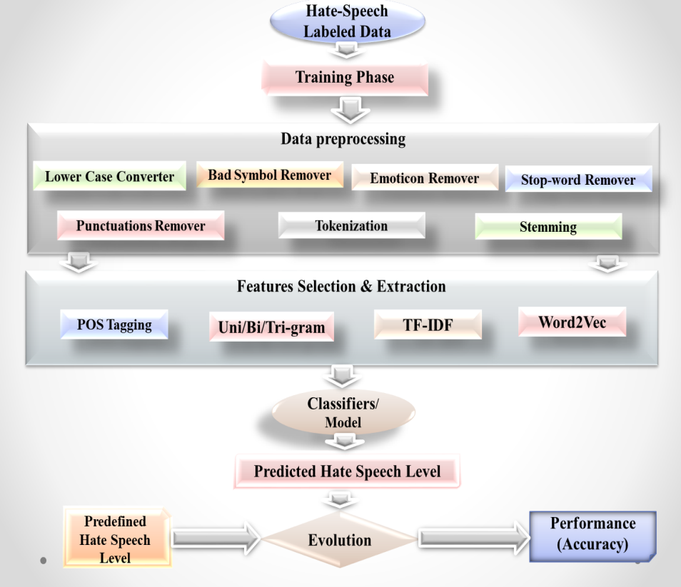
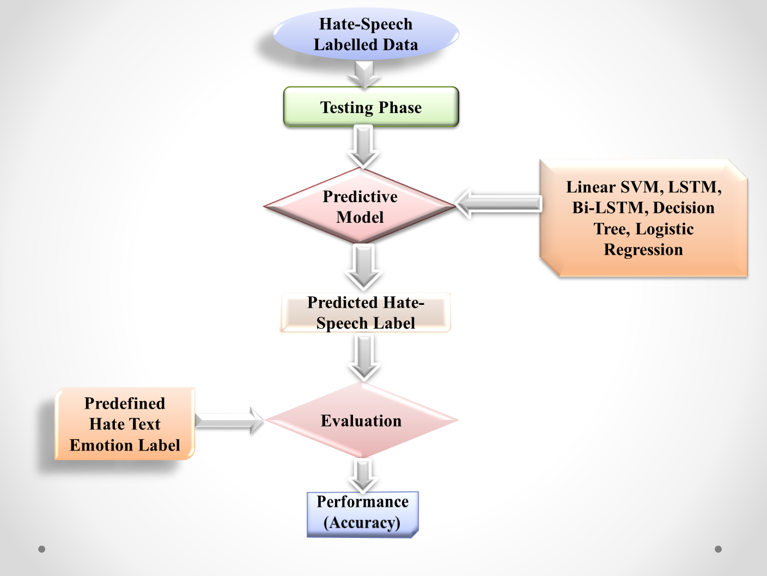
Flowchart
Fig: Architecture of Training Phase
Fig: Architecture of Testing Phase

Slide 14

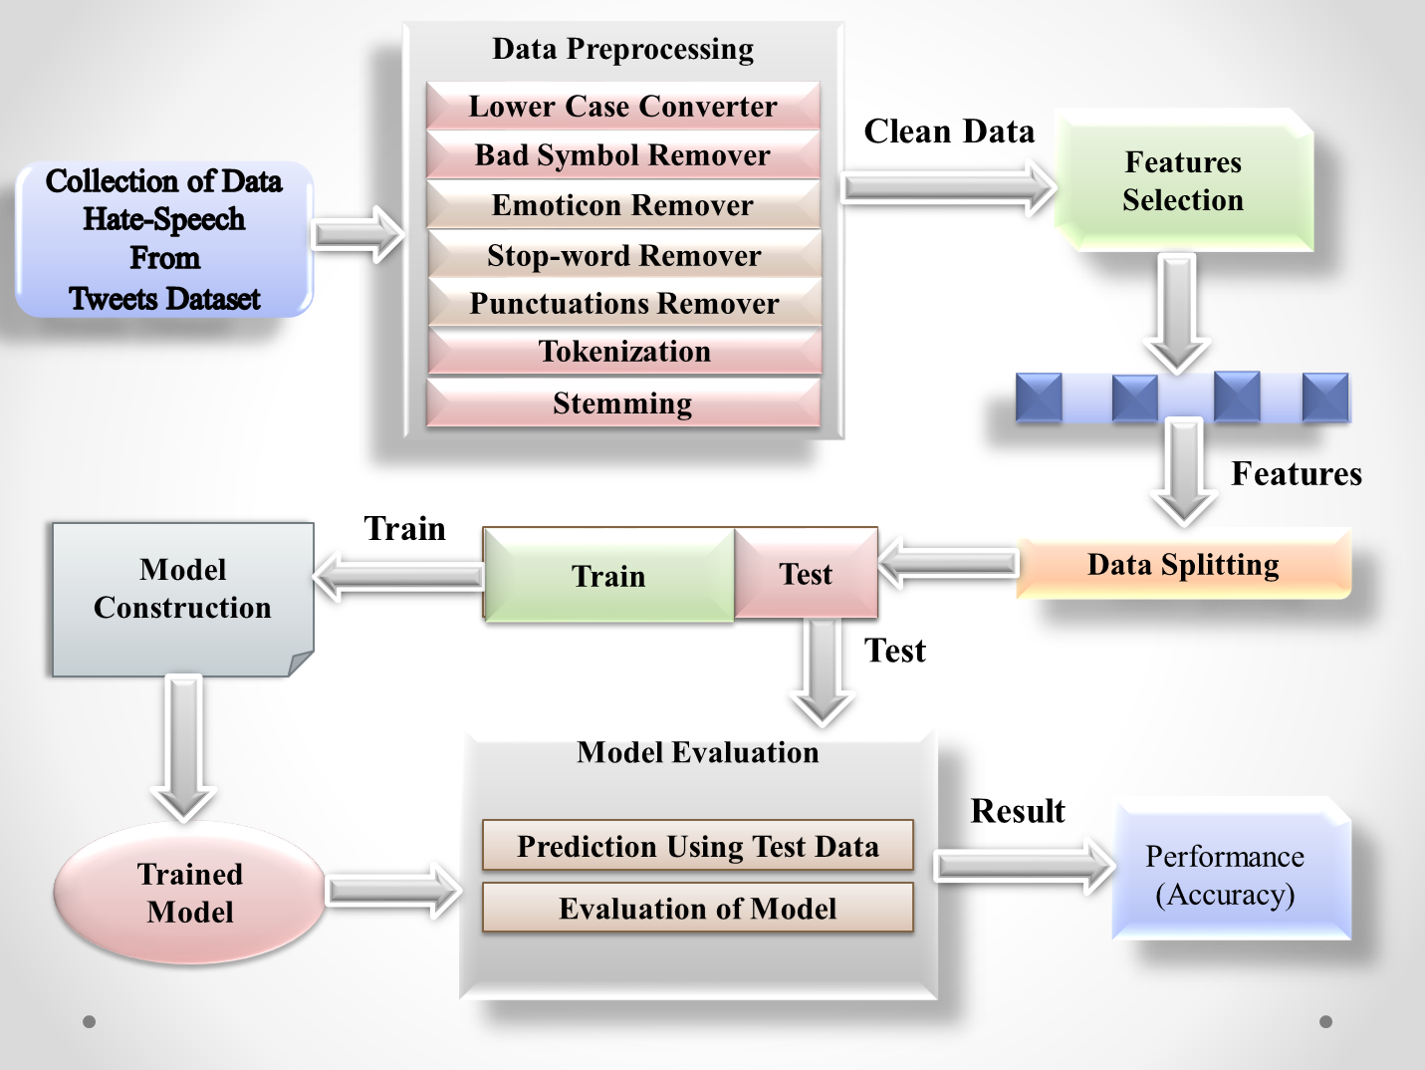
System Overview

Slide 15

Dataset
Label | Train Dataset | Test Dataset
Stupidity | 10033 | 3202
Pathetic | 3825 | 1210
Greedy | 5412 | 1238
Retarded | 1215 | 805
Total | 20485 | 6455
Table: Class distribution in the Dataset
Total words = 265543
Total sentence = 26554

Slide 16

Sample Data
Sample Text | it aint nothing to cut a bitch off
Uni-gram Feature | ‘it’, ‘aint’, ‘nothing’, ‘to’, ‘cut’, ‘a’, ‘bitch’, ‘off’
Bi-gram Feature | ‘it aint’, ‘aint nothing’, ‘nothing to’, ‘to cut’, ‘cut a’, ‘a bitch’, ‘bitch off’
Tri-gram Feature | ‘it aint nothing’, ‘aint nothing to’, ‘nothing to cut’, ‘to cut a’, ‘cut a bitch’, ‘a bitch off’
Table : Uni/ Bi/ Tri- gram

Slide 17

Results
Present a significant benefit for real world
Generalized five different approach
Used probability
Best model detected
Detect four Hate-speech
Sentence Example:
it | aint | nothing | to | cut | a | bitch | off
0.004 | 0.002 | 0.402 | 0.0023 | 0.37 | 0.003 | 0.66 | 0.0012
Table: Sentence split and accuracy

Slide 18

Detail Evaluation
Best approach is Bi-LSTM (87.07%)
Linear SVM (86.18%), LSTM (82.09%), DT (72.23%), and LR (85.16%)
Stupidity class gives quite well
Retarded shows bad result
Hate Emotions | Probability
Stupidity | 0.4898
Pathetic | 0.1867
Greedy | 0.2642
Retarded | 0.0593
Table: Detail evaluation using best model
Rules:
P (Hate Emotion = Stupidity) = Total stupidity data / Total train data

Slide 19

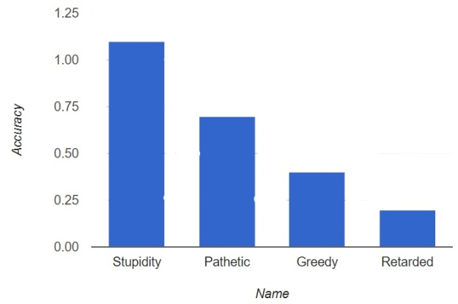
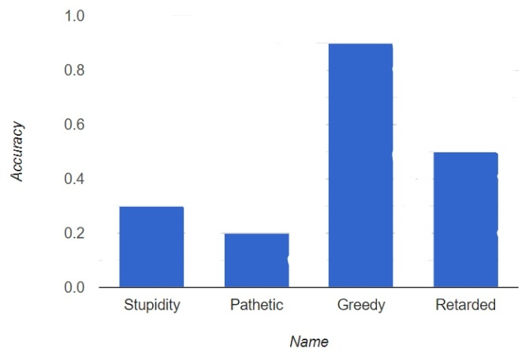
Detect Hate Emotions
Fig: Detect hate emotions (Stupidity)
Fig: Detect hate emotions (Greedy)
Accuracy = 100*correct_prediction/total sentences

Slide 20

Discussions
Convert speech to text
Noticeable number of accuracy found
Best model find
Compared all used approaches
Collected suitable dataset
Dataset synchronized

Slide 21

References
[1]J. M.-D. María Antonia Paz1, Hate Speech: A Systematized Review, Universidad International de La Rioja (UNIR), October-December 2020: 1–.
[2]I. I. D. F. Ashwin Geet D'Sa, Towards Non-Toxic Landscapes: Automatic Toxic Comment Detection Using DNN, F-54000 Nancy, France: University de Lorraine, CNRS, Inria, LORIA.
[3]N. S.-B. L. M. T. V. H. M. H. L. Sergio Andr´es Casta˜no-Pulgarína, Internet, social media and online hate speech. A systematic review, International Journal of Communication, Received 14 July 2020; Received in revised form 26 January 2021; Accepted 23 March 2021.
[4]J. H. T. K. M. N. a. R. P. 6. Salla-Maaria Laaksonen1*, The Datafication of Hate: Expectations and Challenges in Automated Hate Speech Monitoring, Jyväskylä, Finland: Department of Language and Communication Studies, University of Jyväskylä, February 2020 | Volume 3.
[5]W. Y. a. A. Zubiaga, Towards generalizable hate speech detection: a review on obstacles and solutions, United Kingdom: School of Electronic Engineering and Computer Science, Queen Mary University of London, London, 17 June 2021.
[6I. I.. F. Ashwin Geetd'Sa, Classification of Hate Speech Using Deep Neural Words, Université de Lorraine, CNRS, Inria, LORIA.
[7]A. T. ·. E. N. ·. A. S. ·. L. Fontanella3, Thirty years of research into hate speech: topics of interest and their evolution, Scientometrics (2021) 126:157–179, 30 October 2020.
[8]E.Z.W.K.H.S.L Elizaveta Zinovyeva, Antisocial Online Behavior Detection Using Deep Learning, Berlin, Germany: International Research Training Group 1792, ISSN 2568-5619.

Slide 22


